Slide 1
SDLC-Software Development Life Cycle Models
By
Dr. Junaid Akram
Assistant Professor, Department of Computer Science COMSATS (Lahore)

Slide 2
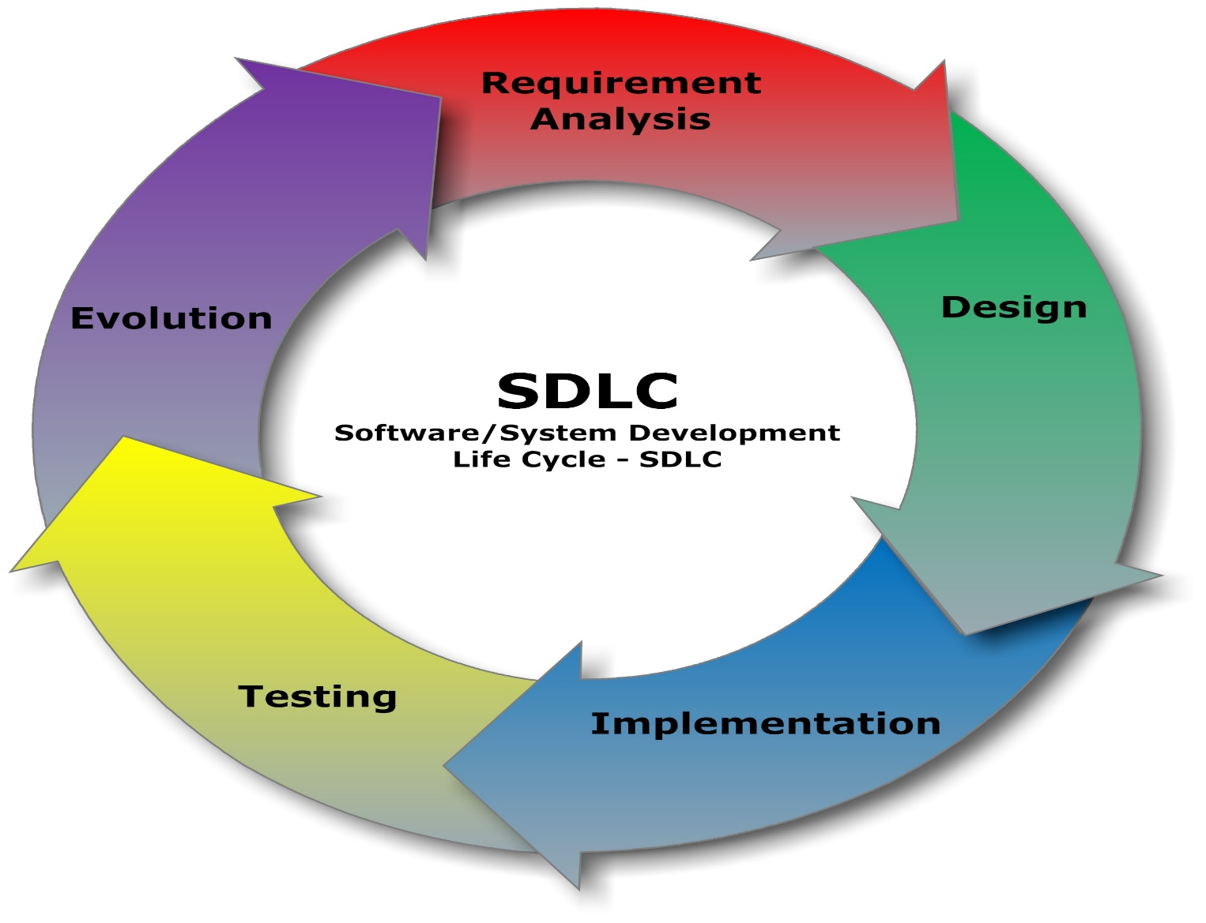
What are the main phases in the lifecycle of a software product?

Slide 3
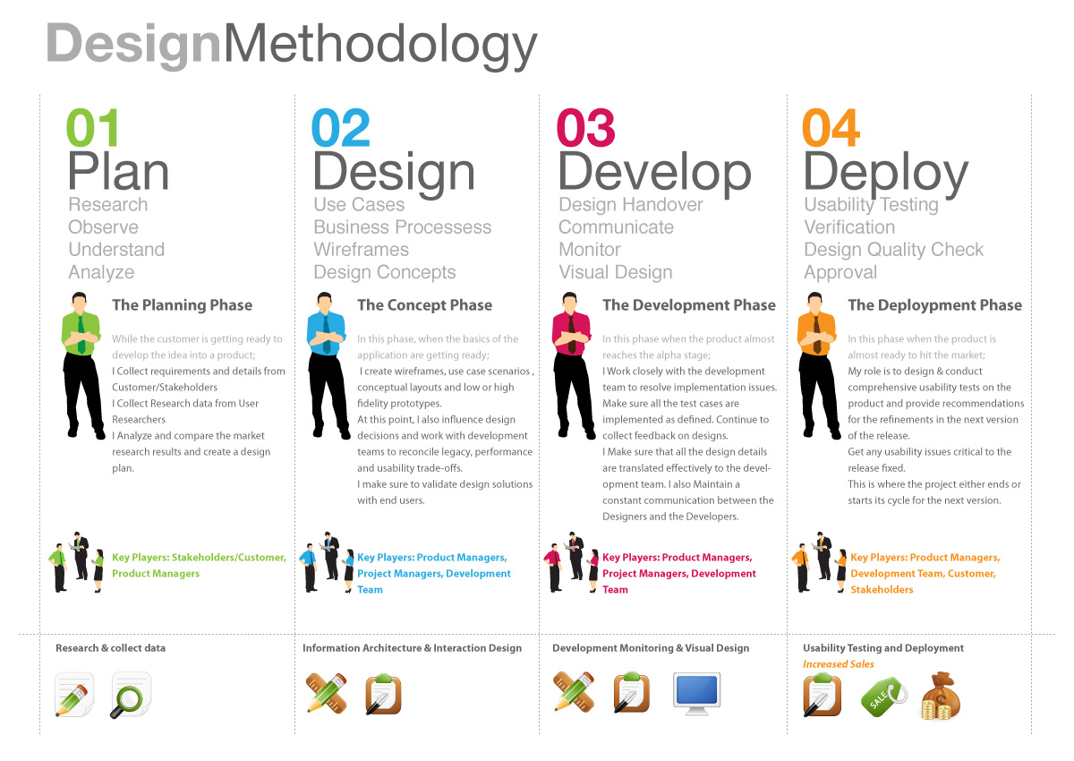

Slide 4
Software Development Life Cycle Models
There are various software development life cycle models.
These models are also referred as Software Development Process Models.
Each process model follows a Series of steps unique to its type to ensure success in the process of software development.
Following are the most important and popular SDLC models followed in the industry
Waterfall Model
Iterative Model
Spiral Model
V-Model
Big Bang Model
Other related methodologies are Agile Model, RAD Model, Rapid Application Development and Prototyping Models

Slide 5
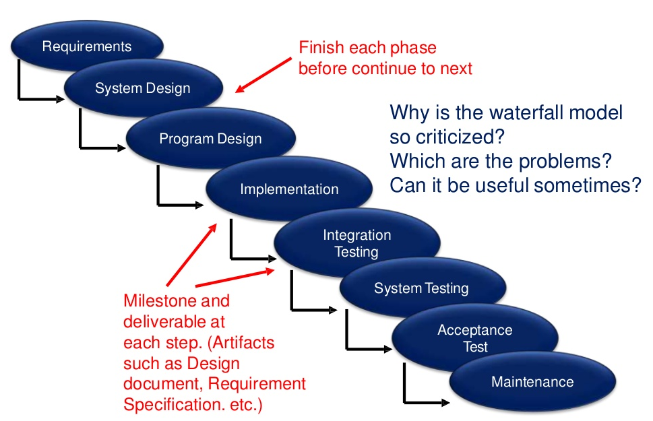
SDLC - Waterfall Model
The Waterfall Model was the first Process Model to be introduced.
It is also referred to as a linear-sequential life cycle model.
It is very simple to understand and use.

Slide 6
SDLC - Waterfall Model
Requirement Gathering and analysis − All possible requirements of the system to be developed are captured in this phase and documented in a requirement specification document.
System Design − The requirement specifications from first phase are studied in this phase and the system design is prepared. This system design helps in specifying hardware and system requirements and helps in defining the overall system architecture.
Implementation − With inputs from the system design, the system is first developed in small programs called units, which are integrated in the next phase. Each unit is developed and tested for its functionality, which is referred to as Unit Testing.
Integration and Testing − All the units developed in the implementation phase are integrated into a system after testing of each unit. Post integration the entire system is tested for any faults and failures.
Deployment of system − Once the functional and non-functional testing is done; the product is deployed in the customer environment or released into the market.
Maintenance − There are some issues which come up in the client environment. To fix those issues, patches are released. Also to enhance the product some better versions are released. Maintenance is done to deliver these changes in the customer environment.

Slide 7
Waterfall Model - Advantages
Simple and easy to understand and use
Easy to manage due to the rigidity of the model. Each phase has specific deliverables and a review process.
Phases are processed and completed one at a time.
Works well for smaller projects where requirements are very well understood.
Clearly defined stages.
Well understood milestones.
Easy to arrange tasks.
Process and results are well documented.

Slide 8
Waterfall Model - Disadvantages
No working software is produced until late during the life cycle.
High amounts of risk and uncertainty.
Poor model for long and ongoing projects.
Not suitable for the projects where requirements are at a moderate to high risk of changing.
It is difficult to measure progress within stages.
Cannot accommodate changing requirements.
Integration is done as a "big-bang” at the very end, which doesn't allow identifying any technological or business bottleneck or challenges early.

Slide 9
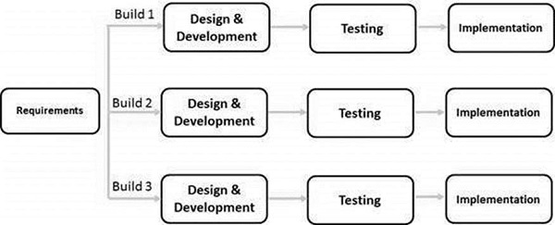
SDLC - Iterative Model
In the Iterative model, iterative process starts with a simple implementation of requirements and iteratively enhances the evolving versions until the complete system is implemented.
An iterative life cycle model does not attempt to start with a full specification of requirements.
This process is then repeated, producing a new version of the software at the end of each iteration of the model.
During software development, more than one iteration of the software development cycle may be in progress at the same time.

Slide 10
Iterative Model - Applications
Requirements of the complete system are clearly defined and understood.
Major requirements must be defined; however, some functionalities or requested enhancements may evolve with time.
There is a time to the market constraint.
A new technology is being used and is being learnt by the development team while working on the project.
Resources with needed skill sets are not available and are planned to be used on contract basis for specific iterations.
There are some high-risk features and goals which may change in the future.

Slide 11
Iterative Model - Advantages
Some working functionality can be developed quickly and early in the life cycle.
Results are obtained early and periodically.
Parallel development can be planned.
Progress can be measured.
Less costly to change the scope/requirements.
Testing and debugging during smaller iteration is easy.
Risks are identified and resolved during iteration.
Easier to manage risk - High risk part is done first.
With every increment, operational product is delivered.
It supports changing requirements.
Initial operating time is less.
Better suited for large and mission-critical projects.
During the life cycle, software is produced early which facilitates customer evaluation and feedback.

Slide 12
Iterative Model - Disadvantages
More resources may be required.
Although cost of change is lesser, but it is not very suitable for changing requirements.
More management attention is required.
System architecture or design issues may arise because not all requirements are gathered in the beginning of the entire life cycle.
Defining increments may require definition of the complete system.
Not suitable for smaller projects.
Management complexity is more.
End of project may not be known which is a risk.
Highly skilled resources are required for risk analysis.

Slide 13
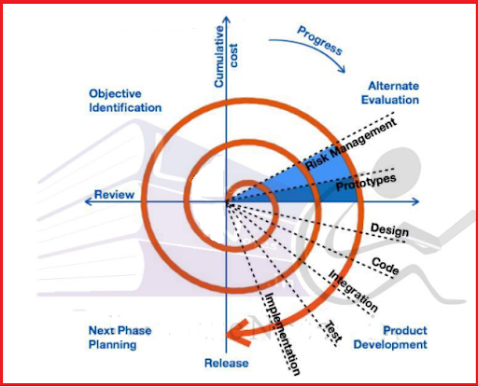
SDLC - Spiral Model
The spiral model has four phases.
A software project repeatedly passes through these phases

Slide 14
Spiral Model Application
When there is a budget constraint and risk evaluation is important.
For medium to high-risk projects.
Long-term project commitment because of potential changes to economic priorities as the requirements change with time.
Customer is not sure of their requirements which is usually the case.
Requirements are complex and need evaluation to get clarity.
New product line which should be released in phases to get enough customer feedback.
Significant changes are expected in the product during the development cycle.

Slide 15
Spiral Model - Advantages
Changing requirements can be accommodated.
Allows extensive use of prototypes.
Requirements can be captured more accurately.
Users see the system early.
Development can be divided into smaller parts and the risky parts can be developed earlier which helps in better risk management.

Slide 16
Spiral Model - Disadvantages
Management is more complex.
End of the project may not be known early.
Not suitable for small or low risk projects and could be expensive for small projects.
Process is complex
Spiral may go on indefinitely.
Large number of intermediate stages requires excessive documentation.

Slide 17
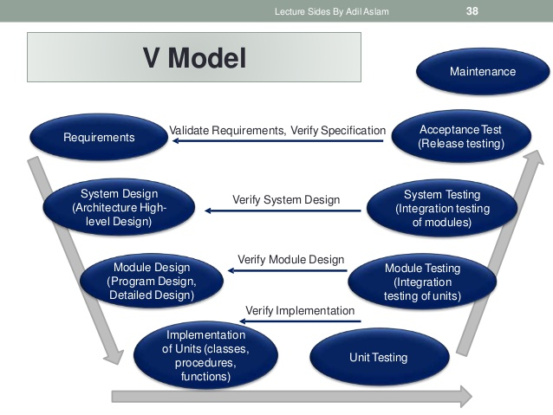
Under the V-Model, testing phase of the development phase is planned in parallel.
So, there are Verification phases on one side of the ‘V’ and Validation phases on the other side.
The Coding Phase joins the two sides of the V-Model.

Slide 18
V- Model ─ Application
Requirements are well defined, clearly documented and fixed.
Product definition is stable.
Technology is not dynamic and is well understood by the project team.
There are no ambiguous or undefined requirements.
The project is short.

Slide 19
V- Model ─ Advantages
This is a highly-disciplined model and Phases are completed one at a time.
Works well for smaller projects where requirements are very well understood.
Simple and easy to understand and use.
Easy to manage due to the rigidity of the model. Each phase has specific deliverables and a review process.

Slide 20
V- Model ─ Disadvantages
High risk and uncertainty.
Not a good model for complex and object-oriented projects.
Poor model for long and ongoing projects.
Not suitable for the projects where requirements are at a moderate to high risk of changing.
Once an application is in the testing stage, it is difficult to go back and change a functionality.
No working software is produced until late during the life cycle.

Slide 21
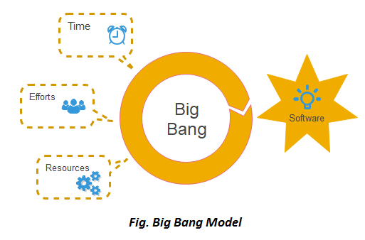
SDLC - Big Bang Model
Do not follow any specific process
The development just starts with the required money and efforts as the input
Usually this model is followed for small projects
Very little planning required
Ideal model for the product where requirements are not well understood

Slide 22
Big Bang Model - Pros and Cons
Advantages
This is a very simple model
Little or no planning required
Easy to manage
Very few resources required
Gives flexibility to developers
It is a good learning aid for new comers or students.
Disadvantages
Very High risk and uncertainty.
Not a good model for complex and object-oriented projects.
Poor model for long and ongoing projects.
Can turn out to be very expensive if requirements are misunderstood.

Slide 23

Thanks for your attention!
Any Question?
Email me on : junaidakram@cuilahore.edu.pk

